Slide 1
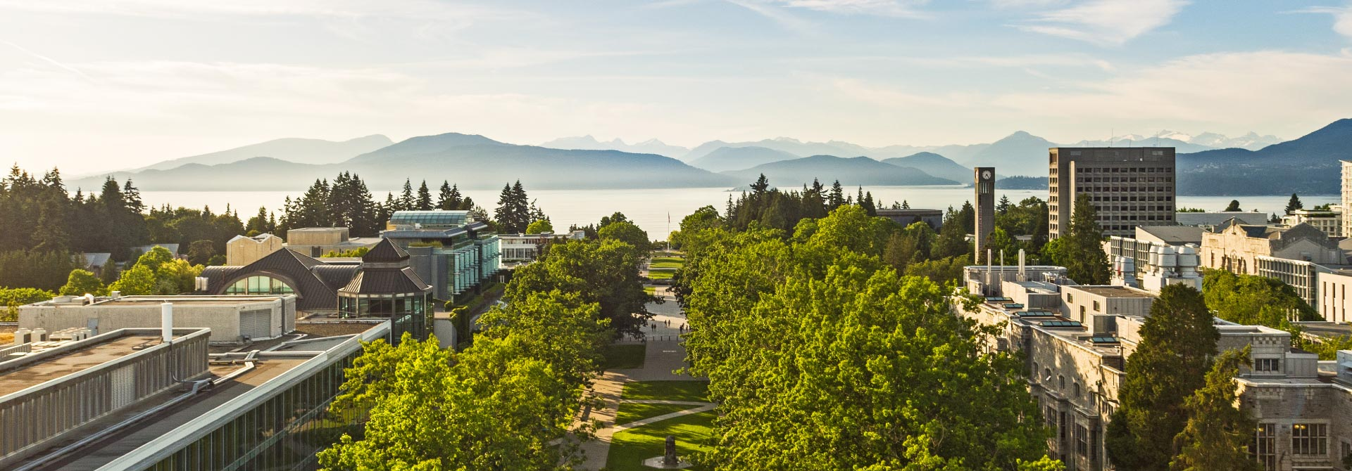
THE UNIVERSITY OF BRITISH COLUMBIA
June 15th – August 15th
Lecturer:
Xingyi Yan
Vancouver Summer Program

Slide 2
PREPARATION
Before the Program
Friends
Cash & Credit Card
SIM Card

Slide 3
Vancouver Summer Program
Living
Studying
Visiting

Slide 4
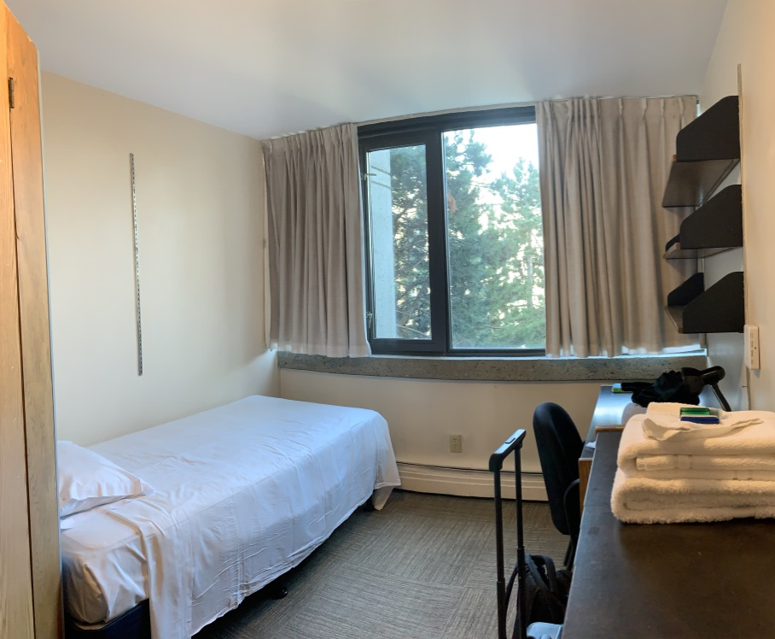
DORMITORY
Everything is prepared.

Slide 5
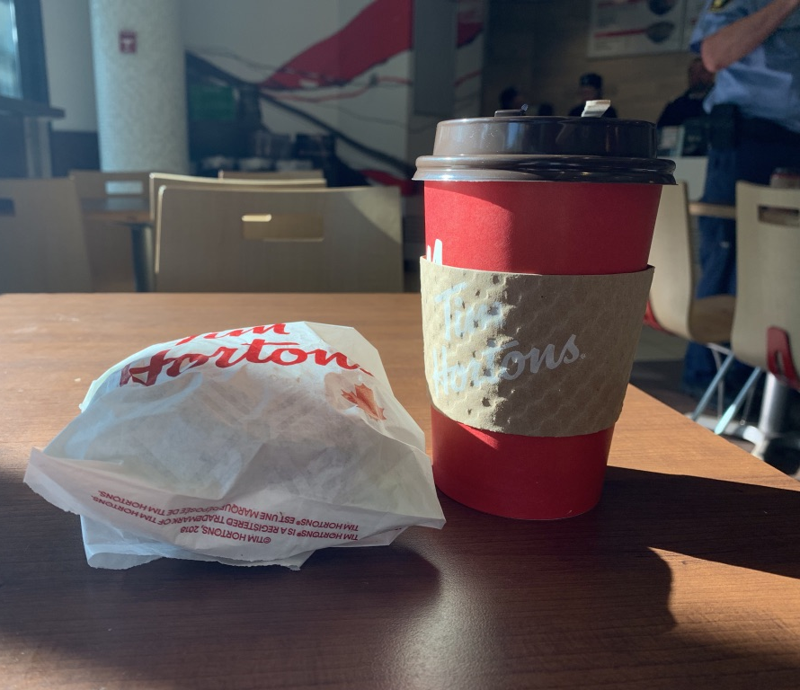
EAT
Pizza & Burger
Chinese Food
Other Fast Food
Cooking Material
$6~10

Slide 6
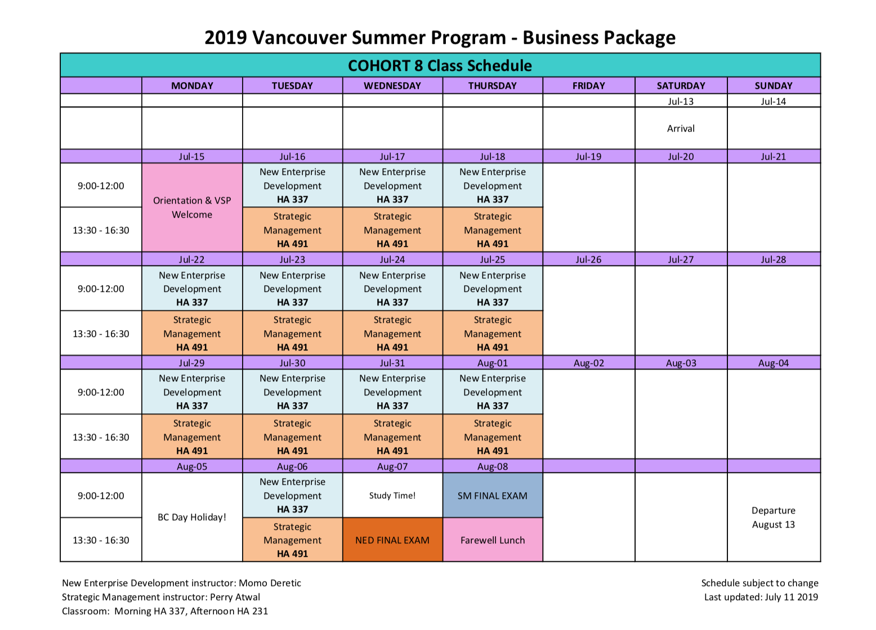
STUDY
6 Hours
4 Days
2+ Assignments
1 Exams

Slide 7
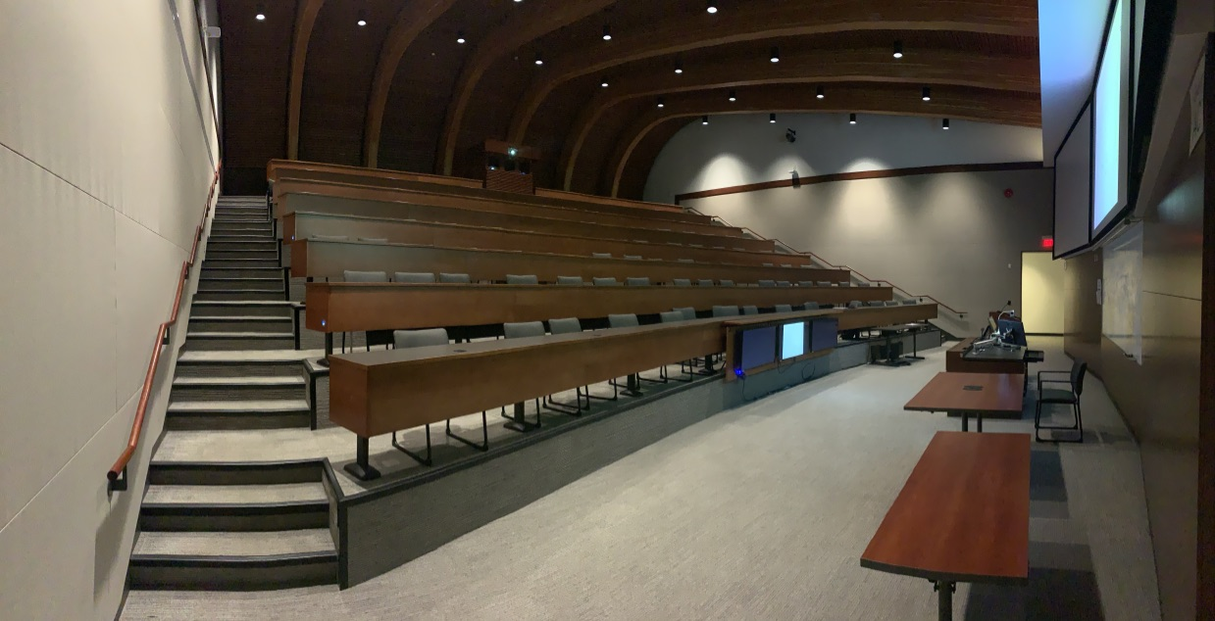
STUDY
Professors are so nice

Slide 8
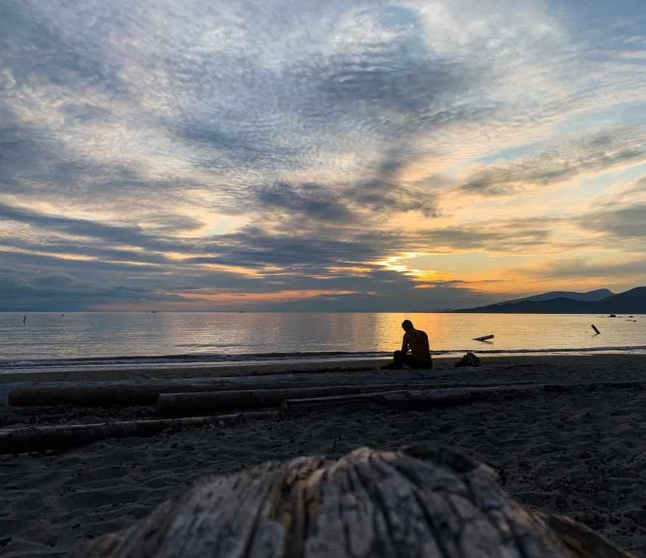
VISIT
Sea & Beach

Slide 9
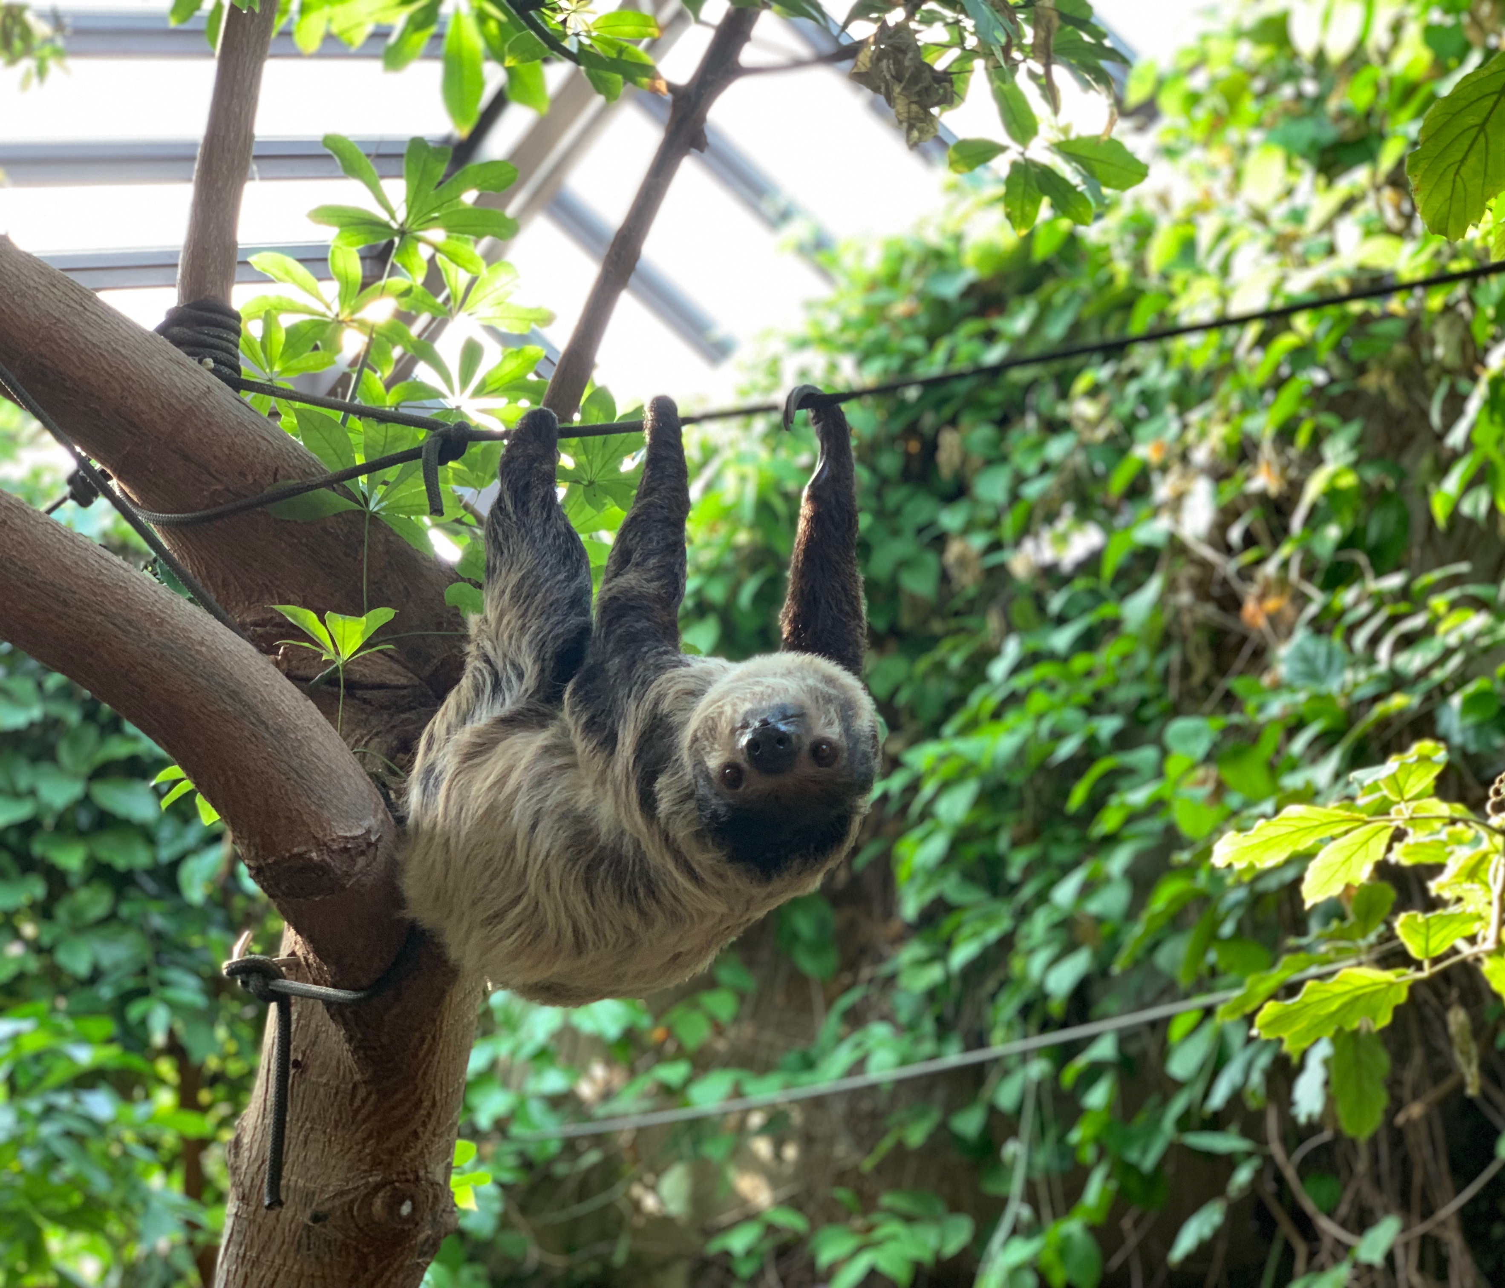
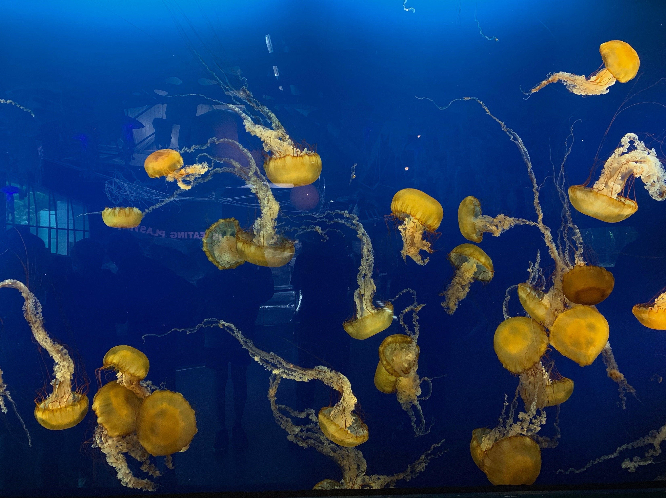
VISIT
Aquaria

Slide 10
VISIT
Firework Festival

Slide 11
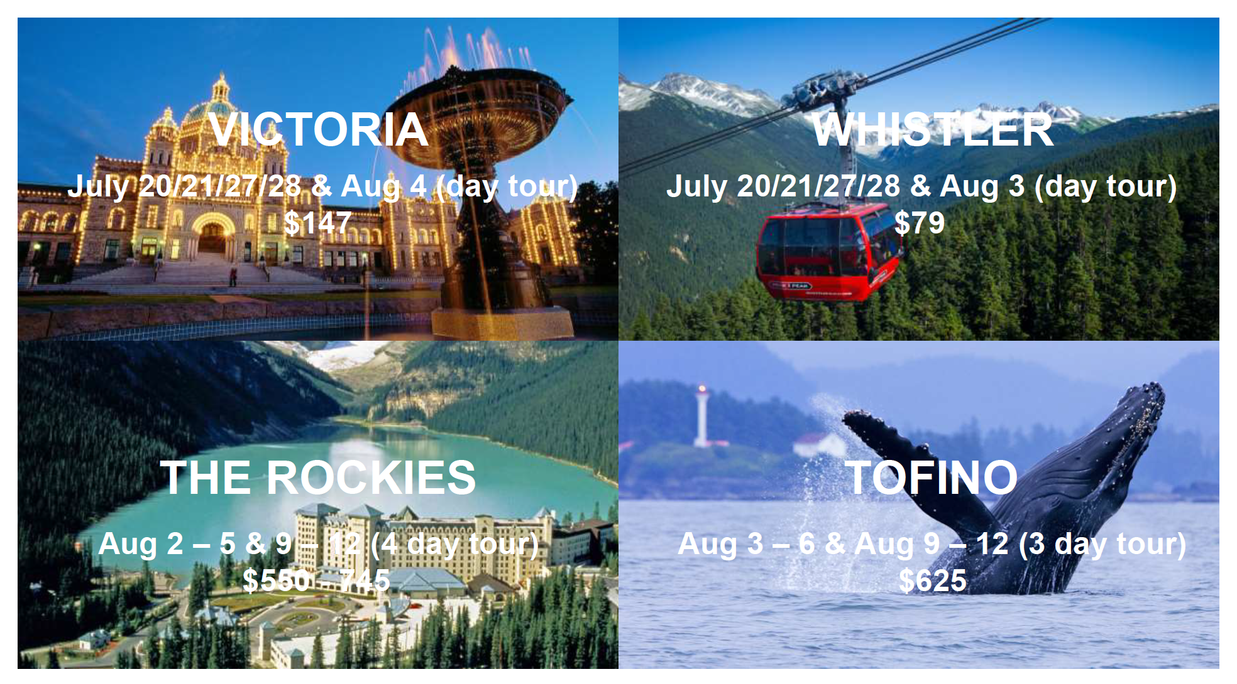

Slide 12
Thanks For Watching

